Slide 1
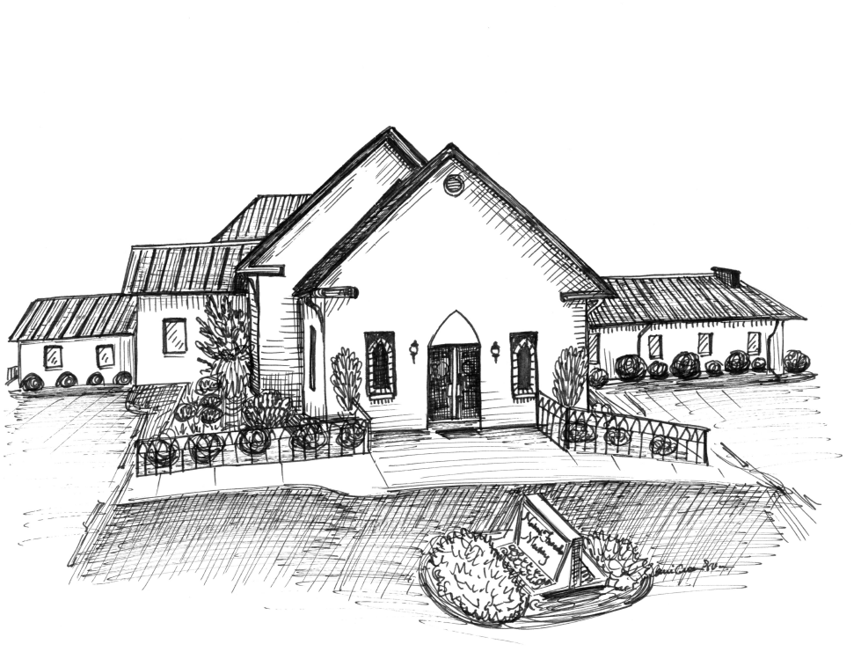
Items needed to replenish the food pantry at
United Church Ministries
Cereal Pop-tarts
Grits Oatmeal
Fruit Grain Bars Granola Bars
Pork & Beans Chunky soups
Rice Pasta
Mashed Potatoes Ramen noodles
Mac & Cheese Spaghetti Sauce and Noodles
Peanut butter Jams/Jellies (store bought)
Canned fruit Chef Boyardee (lasagna, ravioli,spaghetti)
Crackers (Saltines, “nabs”, etc) Canned meats (Vienna sausages, Spam, tuna, ham, chicken)
Canned vegetables (potatoes, carrots, mixed vegetables, beans)
NO CORN OR GREEN BEANS PLEASE!
~~~~~~~~~~~~~~~~~~~~~~~~~~~~~~~~~~~~~~~~~~~~~~~~~~
Union Grove has a food pantry open
1st and 3rd Tuesday of every month
from 10:00 a.m. – 12:00 p.m.
We are donating to this
ministry to help provide food for the needy.
**No Perishable Foods**
~~~~~~~~~~~~~~~~~~~~~~~~~~~~~~~~~~~~~~~~~~~~
2026 Wednesday Night Fellowship Meal Hosts
January – Ministry and Council
February – Hospitality Committee
March – Music and Technology Committees
April – Trustees and Stewardship & Finance Committee
May – Christian Ed Committee
June – No Meal
July – No Meal
August – No Meal
September – Outdoor Ministry
October – Nominating Committee
November – Ministry and Council (Pastor Appreciation)
December – No Meal
~~~~~~~~~~~~~~~~~~~~~~~~~~~~~~~~~~~~~~~~
Attendance and Offering for
Sunday, March 1, 2026
Attendance 81
Offering $4,663.32
Love Offering for
the James/Craft Family $2,099.00
Nahunta Friends
Meeting
2537 NC 581 North Pikeville, NC 27863
Randy Quate, Pastor
Cell: (336) 580-2853
Office: (919) 429-6041

Slide 2

GATHERED FOR WORSHIP
Sunday, March 8, 2026
*******************************************************************************************
Greeter Today…..…….…………………………………………………..Faye Jones
Greeter Next Sunday.………………………………Alex Fields & Hunter Kennedy
Flowers Today…………………………………………………………..Barbara Mills
Flowers Next Sunday……….….....................................................Tammy Taylor
Nursery Today……………………………………….............................Pam Casey
Nursery Next Sunday……….…………………..……………..…Deborah Kennedy
**********************************************************************************
Prayer List:
Joann Aycock, Dennis Coley, Gail Cuddington, David Edgerton and Family, Joanna Edgerton, Travis Edgerton, Mary Friedman, Mary Gardner, Todd Gooding and Jean, Nancy Hillman, Jerry Hinton, Bettina Howard, Cierra Hunter, Danny James and Family, Madison Jenkinson, Lisa Johnson, Joe & Jane McLamb, Barbara Mills, Brian Mooring and his wife, Rudine & Bob Morrison, Bruce Newcomb, Kenneth Pagitt, David & Katharine Peele, Roger Pittman, Joyce Pope, Carol Richardson, Tyler Robinson, Jeff Rose, Nancy Sauls, Faye Scott, Layla Stevens, John Wooten, safety for Vicki Pate’s grandchildren, our Guatemala mission trip, DSS across NC, the people affected by natural disasters around the world along with the rescue workers, the people of Israel, Gaza, Ukraine, Syria, Turkey and Sudan, residence in nursing care centers, farmers, Goldsboro youth, safety for our community and our Country, The Mary Ann Aycock Family, The Wendy Craft Family
Missionaries: Ann Harrington in Malawi
Our Missions in Ministry: Bob and Hope Carter, The Billy Graham Rapid Response Team, Samaritan’s Purse, Friends Disaster Service, Cry Freedom Missions, Wayne Pregnancy Center, Kitty Askins Hospice Center, Fellowship of Christian Athletes, Inspiration Disaster Relief, Fairwinds Aviation
~~~~~~~~~~~~~~~~~~~~~~~~~~~~~~~~~~~~~
**ATTENTION**
New Phone Number for the church
(919) 429-6041
Announcements:
For the week of March 8, 2026
Sunday, March 8th:
- Monthly Meeting immediately following Meeting for
Worship
- Spirit of Nahunta Planning Meeting at 4:00 p.m. in Friends
Hall
- New Member Class at 4:30 p.m. in the Fellowship Hall
- Choir Practice at 6:00 p.m.
Monday, March 9th:
- Lona Edgerton Circle meets at 1:00 p.m.
Wednesday, March 11th:
- Bible Study and Youth Groups meet at 7:00 p.m.
Sunday, March 15th:
- Gideon Speaker and Love Offering during Meeting for
Worship
- New Member Class at 4:30 p.m. in the Fellowship Hall
- Choir Practice at 6:00 p.m.
Wednesday, March 18th:
- Bible Study and Youth Groups meet at 7:00 p.m.
Sunday, March 22nd:
- New Member Class at 4:30 p.m. in the Fellowship Hall
- Choir Practice at 6:00 p.m.
Wednesday, March 25th:
- Bible Study and Youth Groups meet at 7:00 p.m.
Sunday, March 29th:
- New Member Class at 4:30 p.m. in the Fellowship Hall
- Choir Practice at 6:00 p.m.
Wednesday, April 1st:
- Fellowship Meal at 6:00 p.m. Bible Study and Youth
Groups meet at 7:00 p.m. Fellowship meal will be hosted
by the Trustees and Stewardship & Finance Committee. If
you plan to attend the meal please sign up in the vestibule.
Sunday, April 5th:
- Easter Sunrise Service at 7:00 a.m. Breakfast following
Sunrise Service. No Sunday School.
~~~~~~~~~~~~~~~~~~~~~~~~~~~~~~~~~~~~~~~~~~~~~~~~~~
Wayne Pregnancy Center
Baby Bottle Collection
Total = $1,534.86

