Slide 1
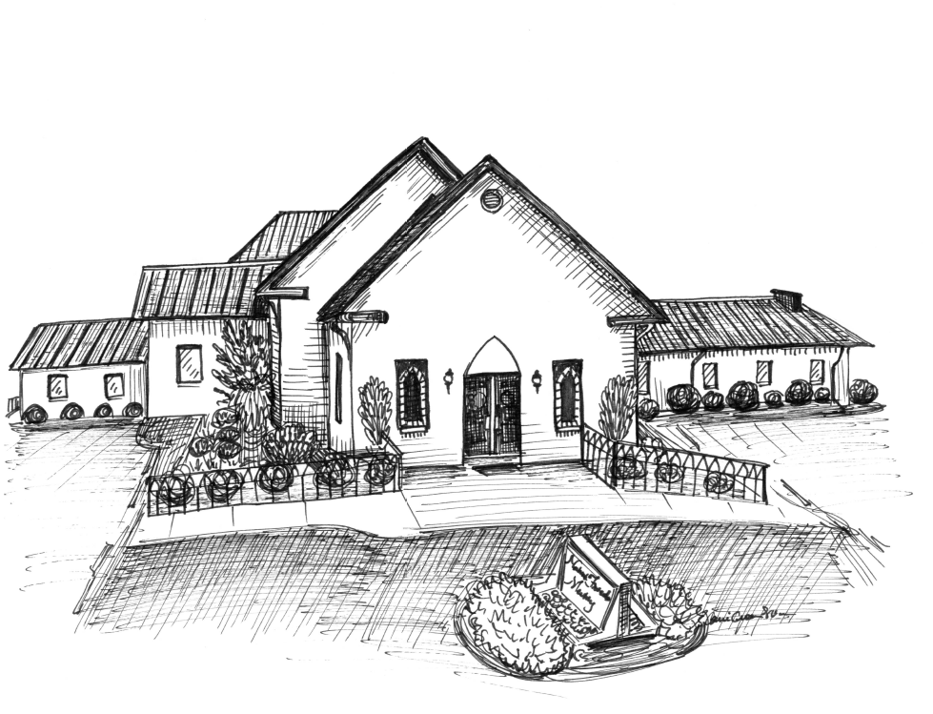
Items needed to replenish the food pantry at
United Church Ministries
Cereal Pop-tarts
Grits Oatmeal
Fruit Grain Bars Granola Bars
Pork & Beans Chunky soups
Rice Pasta
Mashed Potatoes Ramen noodles
Mac & Cheese Spaghetti Sauce and Noodles
Peanut butter Jams/Jellies (store bought)
Canned fruit Chef Boyardee (lasagna, ravioli,spaghetti)
Crackers (Saltines, “nabs”, etc) Canned meats (Vienna sausages, Spam, tuna, ham, chicken)
Canned vegetables (potatoes, carrots, mixed vegetables, beans)
NO CORN OR GREEN BEANS PLEASE!
~~~~~~~~~~~~~~~~~~~~~~~~~~~~~~~~~~~~~~~~~~~~~~~~~~
Union Grove has a food pantry open
1st and 3rd Tuesday of every month
from 10:00 a.m. – 12:00 p.m.
We are donating to this
ministry to help provide food for the needy.
**No Perishable Foods**
~~~~~~~~~~~~~~~~~~~~~~~~~~~~~~~~~~~~~~~~
Summer Reading Program
Stop by the Children’s Library
Between Sunday School and Worship
Preschool thru high school
There will be a celebration party
for all who complete the program
Any questions, please see one of the
library committee members:
Deana Gardner, Kathie Fields or Thesia Howell
~~~~~~~~~~~~~~~~~~~~~~~~~~~~~~~~~~~~~~~~
Attendance and Offering for
Sunday, July 5, 2026
Attendance 86
Offering $3,944.10
Nahunta Friends
Meeting
2537 NC 581 North Pikeville, NC 27863
Randy Quate, Pastor
Cell: (336) 580-2853
Office: (919) 429-6041

Slide 2

GATHERED FOR WORSHIP
Sunday, July 12, 2026
*******************************************************************************************
Greeter Today…..…….…………………………….Alex Fields & Hunter Kennedy
Greeter Next Sunday………………………………………….John & Barbara Mills
Flowers Today……………………………………………………...............Julie Hall
Flowers Next Sunday……….…...............................................Deborah Kennedy
Nursery Today……………………………………….............................Pam Casey
Nursery Next Sunday……….……………………………………Deborah Kennedy
**********************************************************************************
Prayer List:
Joann Aycock, Anna Dean, David Edgerton and Family, Travis Edgerton, Mary & Steve Friedman, Joseph Futrell, Nancy Hillman, Lynne Hinnant, Jerry Hinton, Bettina Howard, Cierra Hunter, Lyle Irwin, Madison Jenkinson, Lisa Johnson, Joe & Jane McLamb, Barbara Mills, Brian Mooring and his wife, Rudine & Bob Morrison, Kenneth Pagitt, Gwen Pate, Reagan Peaks and Family, David & Katharine Peele, Roger Pittman and his family, Carol Richardson, Tyler Robinson, Jeff Rose and his family, Hazel Pittman Rowe, Lois & Wayne Sasser, Faye Scott, Bryan Taylor, Sawyer Thomas and Family, Beverly Wiggins, the expectant mothers in our meeting, safety for Vicki Pate’s grandchildren, our Guatemala mission trip, DSS across NC, the people affected by natural disasters around the world along with the rescue workers, the people of the Middle East, residents in nursing care centers, farmers, the youth of Goldsboro, safety for our community and our Country, The Joyce Pope Family, The David Wiley Family
Missionaries: Ann Harrington in Malawi
Our Missions in Ministry: Bob and Hope Carter, The Billy Graham Rapid Response Team, Samaritan’s Purse, Friends Disaster Service, Cry Freedom Missions, Wayne Pregnancy Center, Kitty Askins Hospice Center, Fellowship of Christian Athletes, Inspiration Disaster Relief, Fairwinds Aviation
.
Announcements:
For the week of July 12, 2026
Sunday, July 12th:
- Monthly Meeting immediately following Meeting for
Worship
Monday, July 13th:
- Lona Edgerton Circle meets at 1:00 p.m.
Sunday, July 12th – Thursday, July 16th:
- Vacation Bible School
Wednesday, July 22nd:
- Choir Practice at 7:00 p.m.
Wednesday, July 29th:
- Choir Practice at 7:00 p.m.
Tuesday, August 4th:
- 1:00 Community Prayer Meeting at Nahunta
Wednesday, August 5th:
- Choir Practice at 7:00 p.m.
Sunday, August 9th:
- Monthly Meeting immediately following Meeting for
Worship
- Annual Pool Party at Nahunta Pool from 6:00 – 8:00 p.m.
~~~~~~~~~~~~~~~~~~~~~~~~~~~~~~~~~~~~~~~~~~~~~~~~~~

